Slide 1
Presentation – PROG6212
ST10448839 – Raihaan Rajah

Slide 2
Purpose for the Application
The Contract Monthly Claim System allows lecturers to easily submit their monthly claims, lets managers review and approve them efficiently, and provides coordinators with an overview of all claims to ensure transparency and accountability.
It streamlines the claim process, reduces paperwork, and ensures accurate tracking of payments.

Slide 3
Users
There are three users:
Lecturer User: They are responsible for submitting the claims.
Manager User: They have the responsibility of approving or rejecting the submitted claims.
Coordinator User: They just have a clear overview of the application.

Slide 4
Features
The system allows lecturers to submit monthly claims with multiple activities, attach supporting documents, and track the status of their submissions. Managers can review, approve, or reject claims, while coordinators can oversee the entire process. Automated validation and reporting features ensure accuracy and efficiency.

Slide 5
Database
The database stores all information related to the Contract Monthly Claim System, including lecturers, claims, and individual claim items. Each lecturer has a unique ID, name, email, and phone number. Claims are linked to lecturers and include details such as the month, status, submission date, and any attached documents. Claim items capture the activity description, hours worked, rate, notes, and total payment.
The database structure ensures data integrity and easy retrieval of information. It supports features like viewing claim history, generating reports, and validating claims automatically. Relationships between tables allow the system to efficiently manage, update, and display accurate claim and lecturer information for both lecturers and managers.

Slide 6
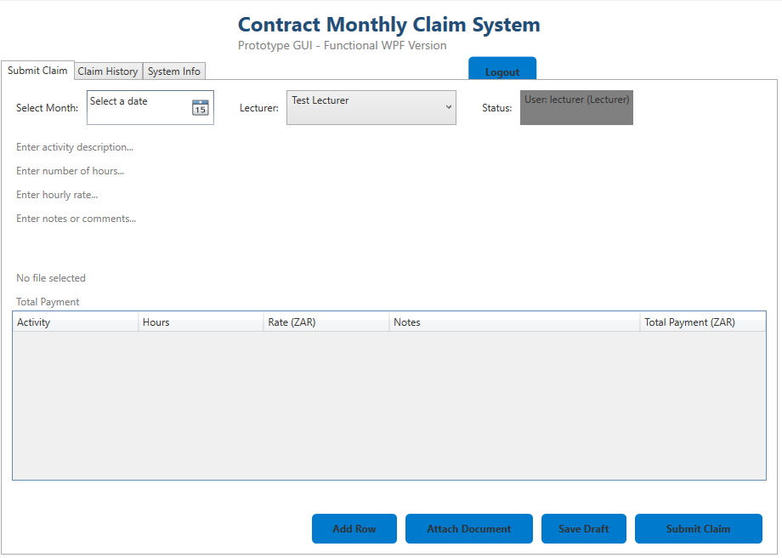
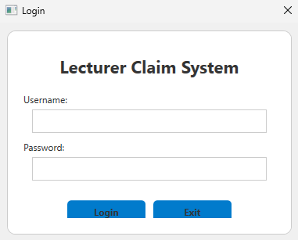
Screenshots

Slide 7
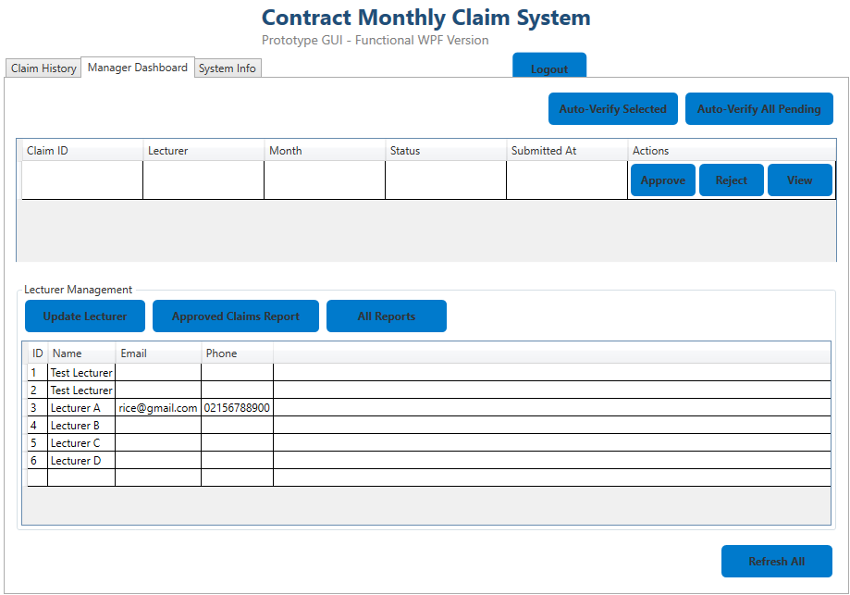
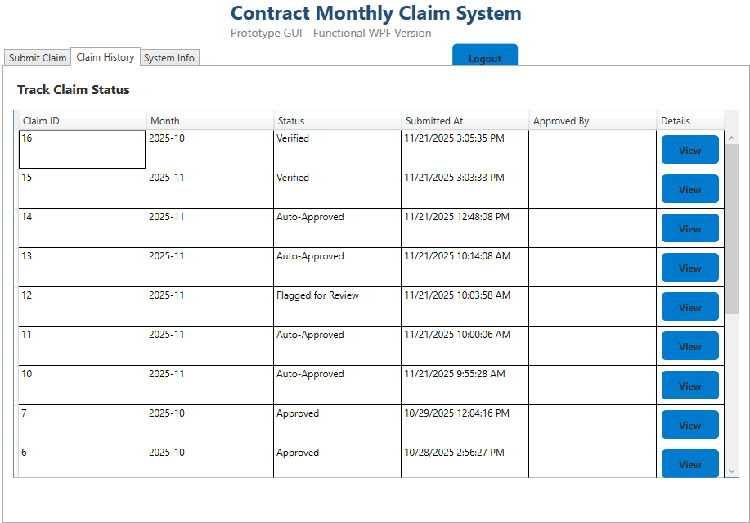
Screenshots Continued

Slide 8
Benefits
The Contract Monthly Claim System simplifies the claim submission and approval process, saving time for both lecturers and managers. By digitizing the workflow, it eliminates the need for paper forms and manual tracking, reducing errors and delays.
The system provides clear visibility of claim statuses, allowing lecturers to monitor their submissions and managers to efficiently review and approve claims. Automated calculations and validation ensure accuracy in payments and compliance with institutional policies.
Overall, the system improves productivity, transparency, and accountability. It ensures that all claims are processed consistently, supports easy reporting, and provides a professional, centralized platform for managing monthly contract claims.

Slide 9
The End

